Slide 1
Modulation Synthesis
MUS 4745

Slide 2
Distortion Synthesis
Synthesis by Modulation
Amplitude Modulation (AM)
Ring Modulation
Frequency Modulation (FM)
Waveshaping

Slide 3
What is Modulation?
Modulation is the alteration of the amplitude, phase or frequency of an oscillator by another signal
In musical terms:
tremolo
vibrato

Slide 4
Amplitude Modulation
AM is the regular change of amplitude by another signal
Main signal is called the carrier
Modulating signal affects the amplitude of the carrier

Slide 5
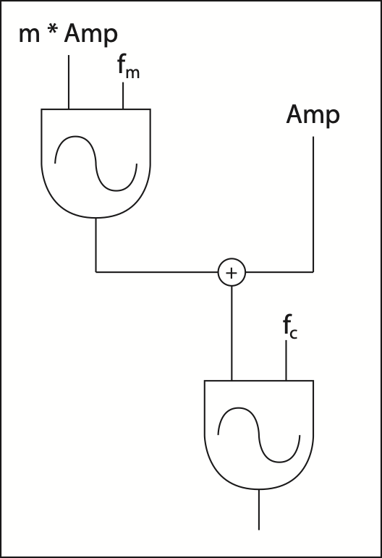

AM Parameters
Carrier Frequency: $f_{c}$
Modulation Frequency: $f_{m}$
Modulation Index: $m$
m = 0, no modulation
m = 1, 100% modulation

Slide 6
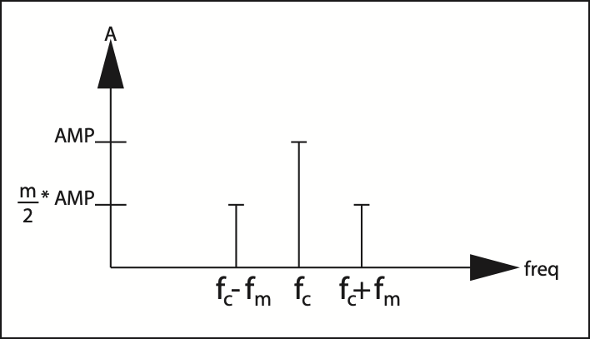
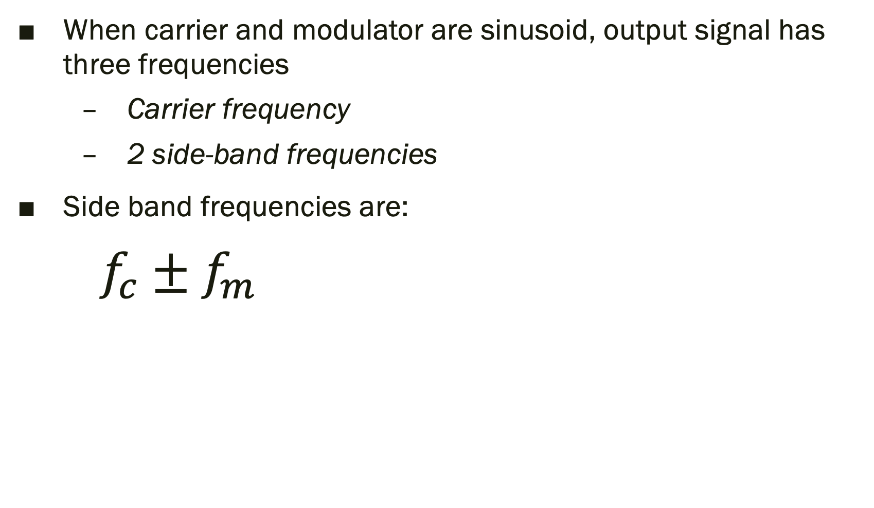
AM Synthesis
When carrier and modulator are sinusoid, output signal has three frequencies
Carrier frequency
2 side-band frequencies
Side band frequencies are:
$f_{c}±f_{m}$

Slide 7

AM vs. Tremolo
When the frequency of amplitude change is less than 10 Hz, we hear the amplitude change
When it is 10-20 Hz, we hear increased loudness
When it is greater than 20 Hz we hear side-bands

Slide 8
Ring Modulation
Ring modulation occurs when the modulation is applied directly to the amplitude input of the carrier oscillator
Also known as double-sided modulation (DSM)
The output from Ring Modulation does not include the carrier… only the side bands.

Slide 9
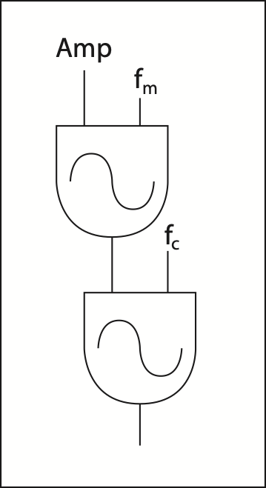
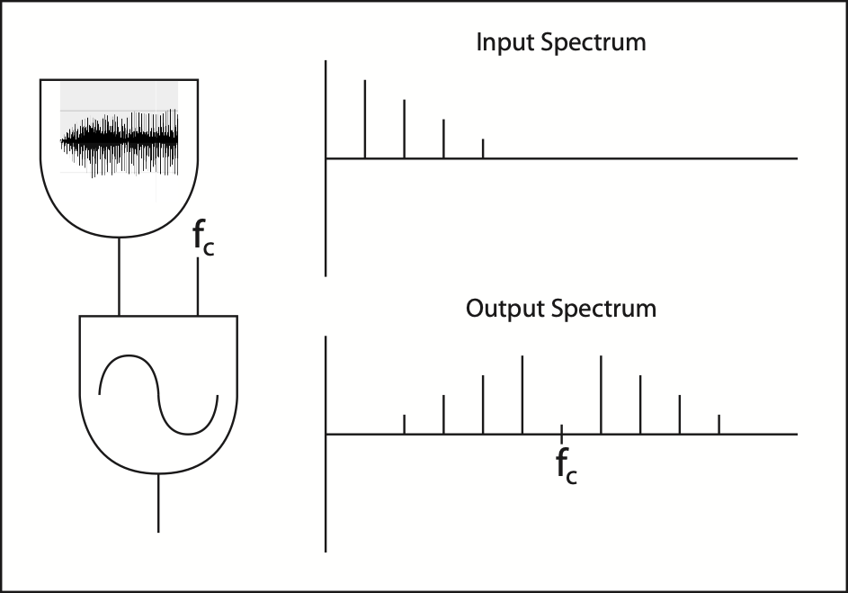
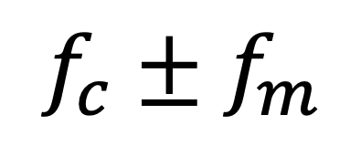
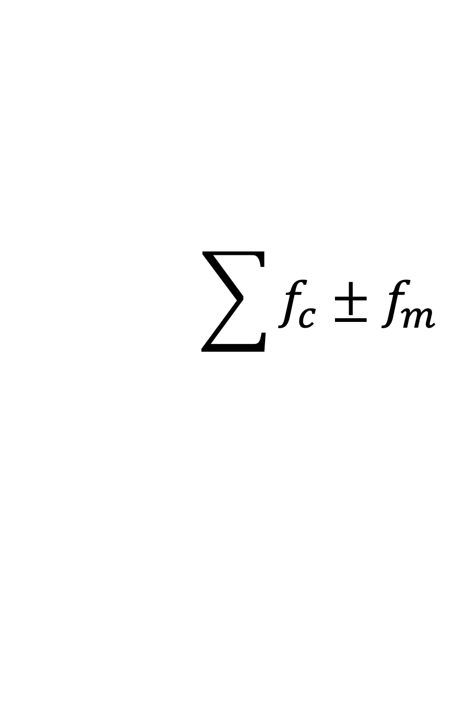
Ring Modulation
Sinusoid RM
Signal RM
$$f_{c}±f_{m}$$
$$\sum{f_{c}±f_{m}}$$

Slide 10
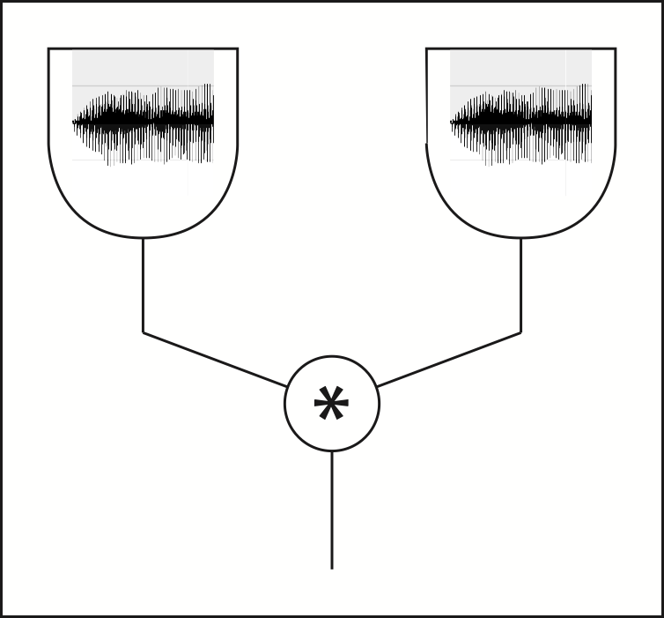
Ring Modulation
RM can also be realized by simply multiplying two signals together
Output spectrum is the sum and difference of each component frequency on one another

Slide 11
Frequency Modulation
Technique pioneered by John Chowning (ca. 1967)
When the vibrato frequency enters the audio domain (20 Hz), we begin to hear sidebands.
Fun and harmonic things happen under the right conditions
Examples:
5 Hz vibrato at 5 Hz depth
5 Hz vibrato at 50 Hz depth
50 Hz vibrato at 50 Hz depth

Slide 12
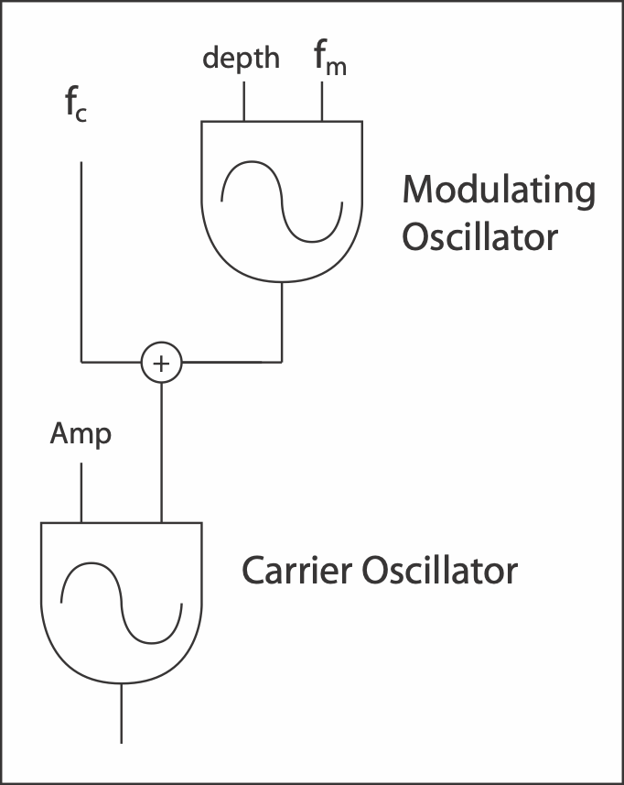
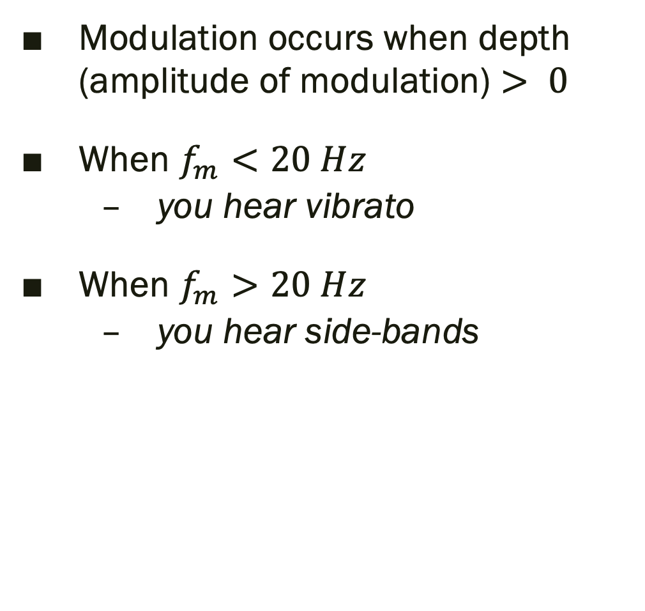
Simple FM Instrument
Modulation occurs when depth (amplitude of modulation) $> 0$
When $f_{m}<20 Hz$
you hear vibrato
When $f_{m}>20 Hz$
you hear side-bands

Slide 13
Simple FM Instrument
Side-bands occur similarly to AM
Number of side-bands is determined by the Modulation Index (I)

Slide 14
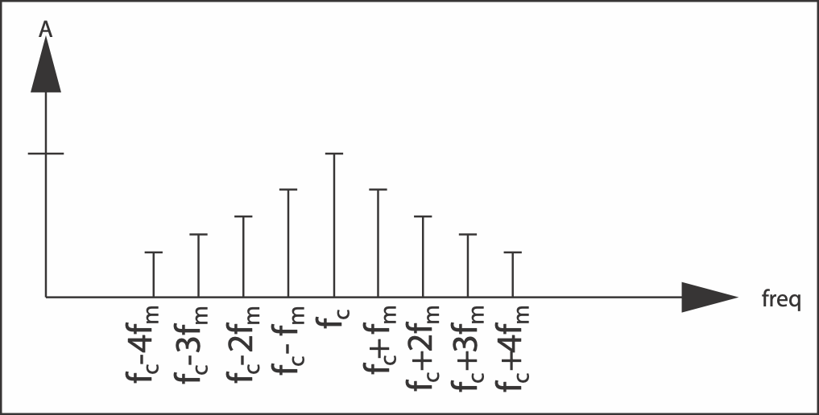
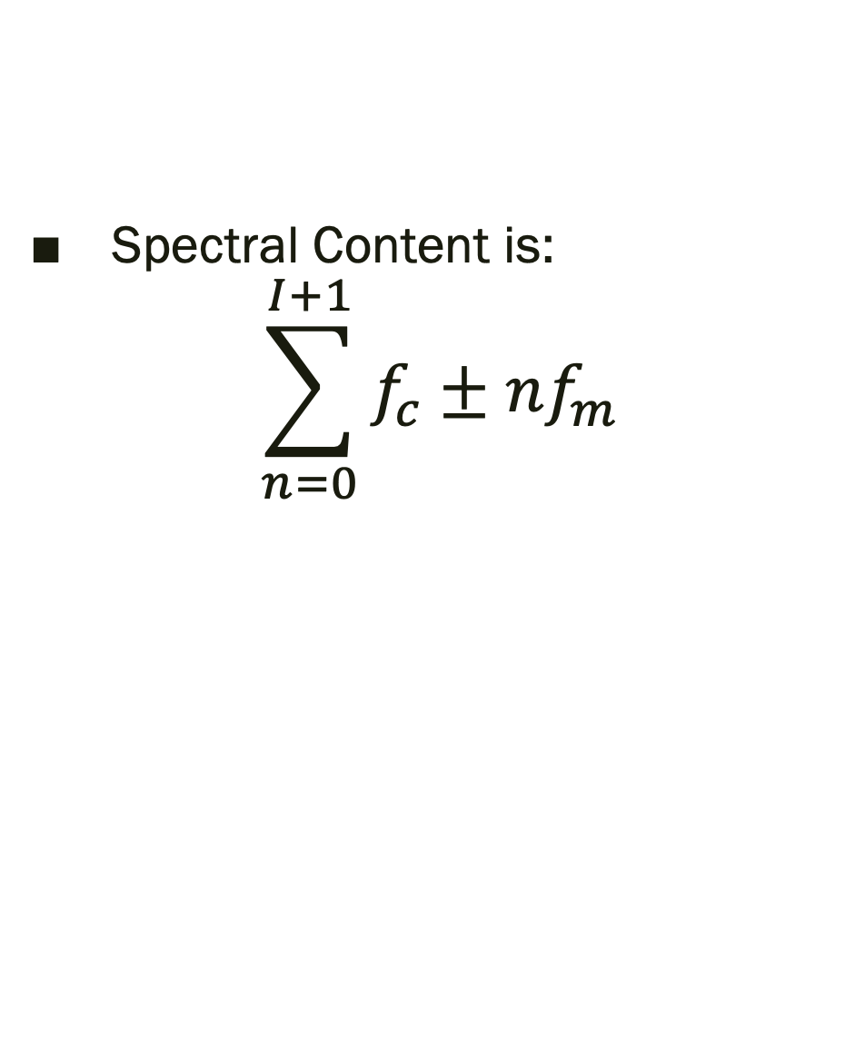
FM Spectral Content
Spectral Content is:
$$\sum_{n=0}^{I+1}{f_{c}±nf_{m}}$$

Slide 15
C:M ratio
The C:M ratio is the ratio between the carrier frequency and the modulating frequency
When C:M is integers, harmonic spectra occurs
When C:M is not integer, inharmonic spectra occurs

Slide 16
Dynamic FM
Apply an envelope to the Modulation Index, and you have
Look at Simple FM in Max!
Algorithmic-beats.maxpat Dynamic Spectra!

Slide 17
FM & Acoustic Viability
Acoustic Viability
Relate key velocity or dynamics to increased spectral energy
FM
Modulation Index controls spectral energy
Connect Key Velocity to Mod Index!

